Slide 1

Enforcement Issues with Glove and Garment Statements
Jack Peterson
Arizona Department of Agriculture
jpeterson@azda.gov
602-542-3575

Slide 2


Issues of importance -
Told you
3rd time violation
Harm to environment or people

Slide 3
So is PPE really an issue
3 years of statistics were used
January 1, 2010 through December 31, 2012


Slide 4
60 Worker Protection & Safety [WPS] Cases were opened.
14 PPE violations were included in these.


Slide 6
There were 11 penalties associated with Cases that included a PPE violation.


Slide 7
The maximum penalty was $1,360
The minimum penalty was $287
The average of the 11 penalties was $785


Slide 8
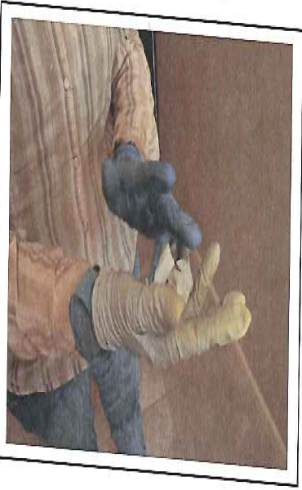
Lunch Lady

Slide 9
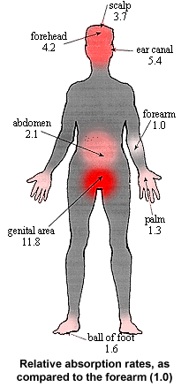
Most common route

Slide 10
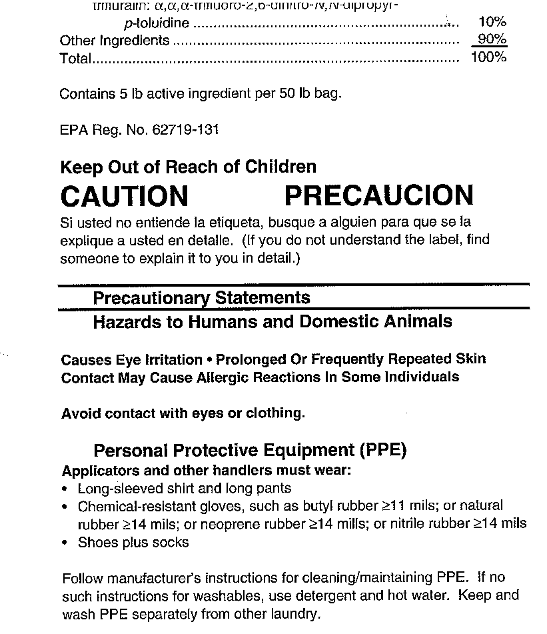
Let’s look at what some labels say

Slide 11
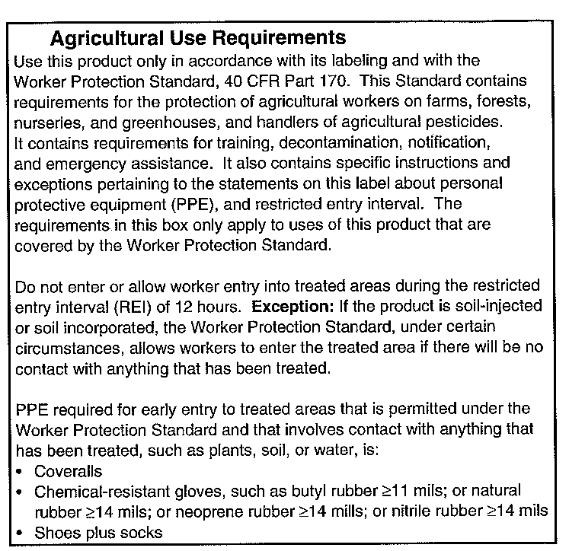

Slide 12
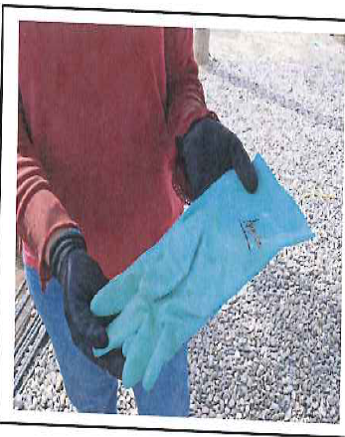
Lunch Lady

Slide 13
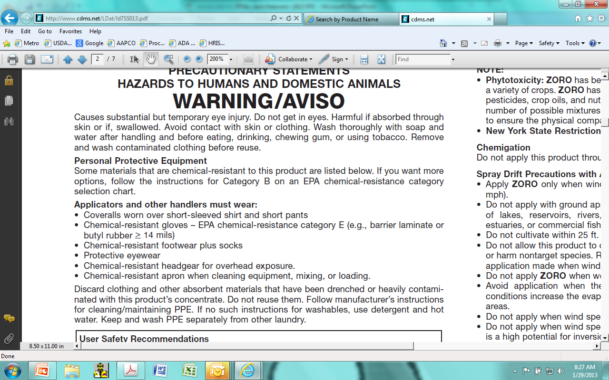

Slide 14
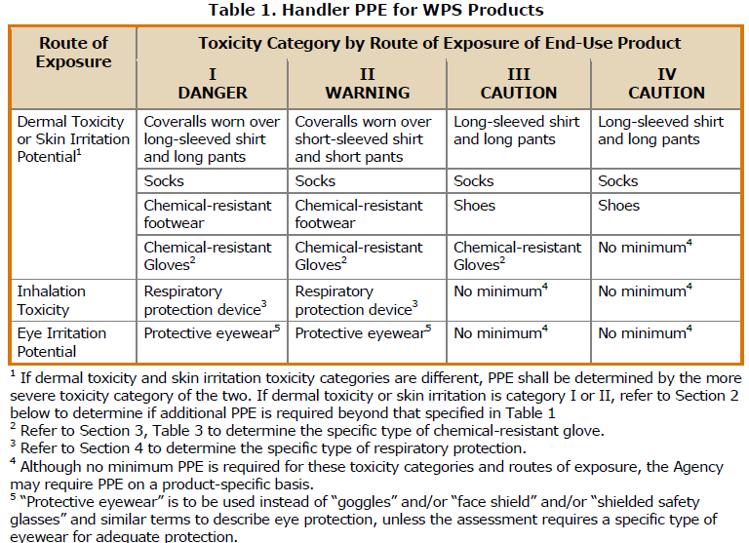
What does the label review manual say?

Slide 15
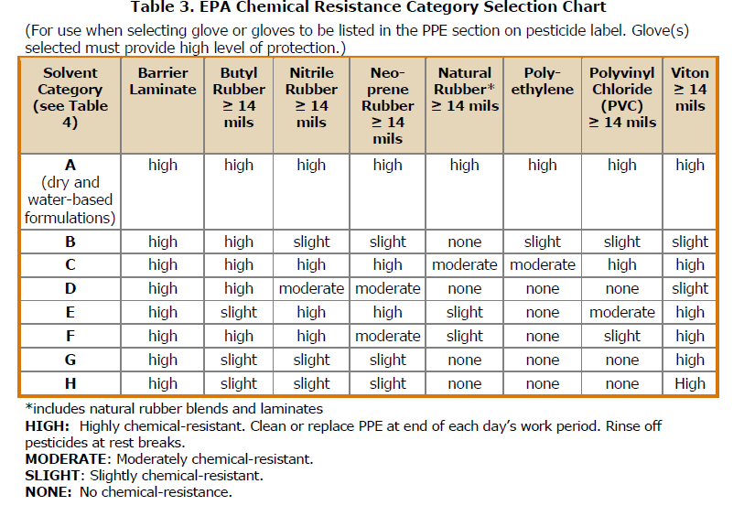

Slide 16
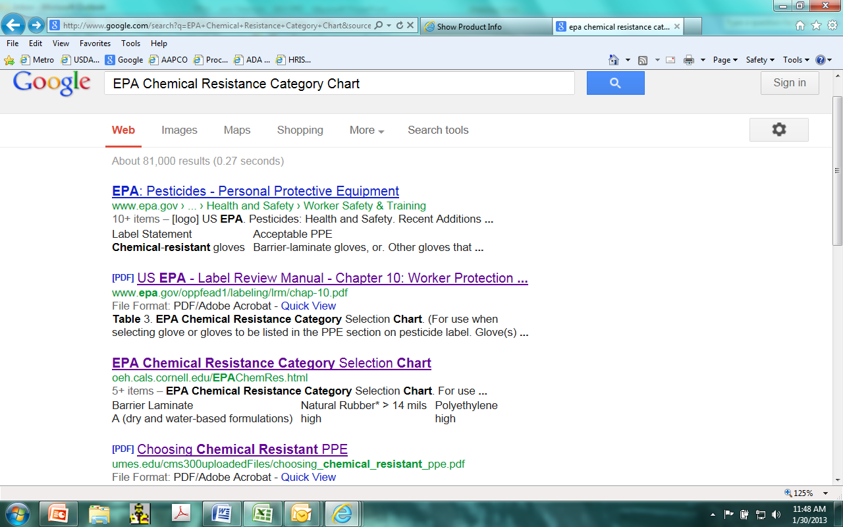

Slide 17
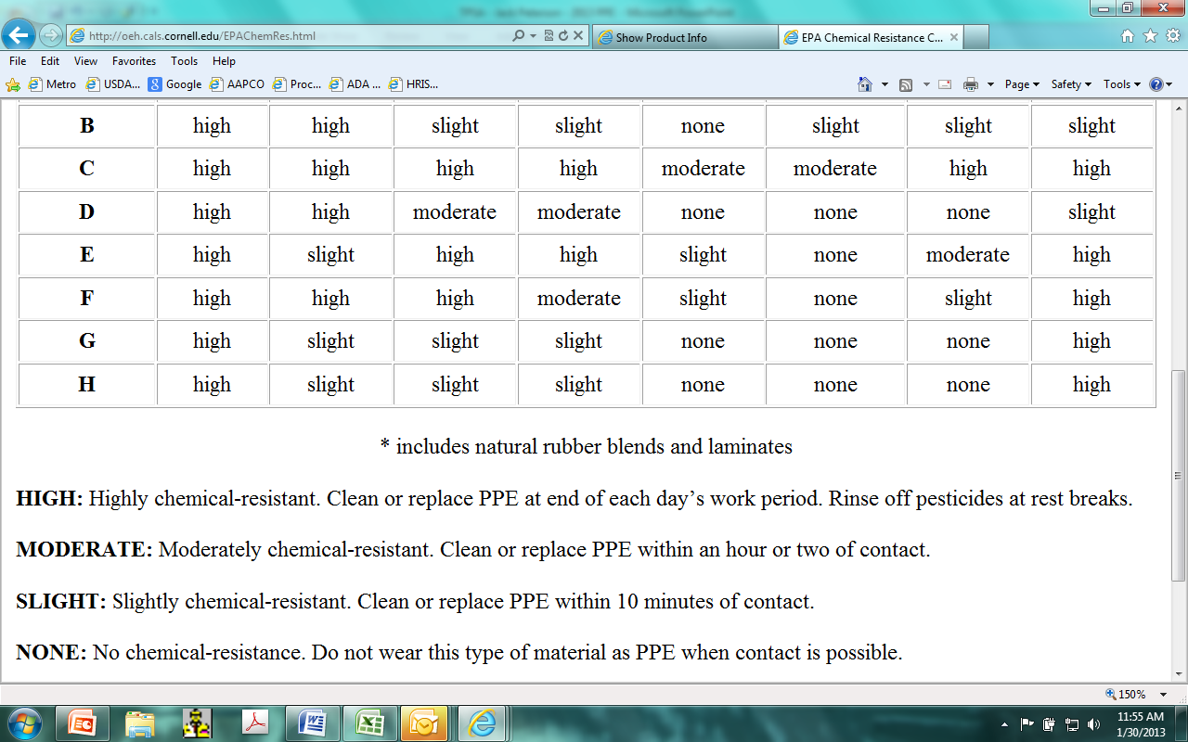

Slide 18
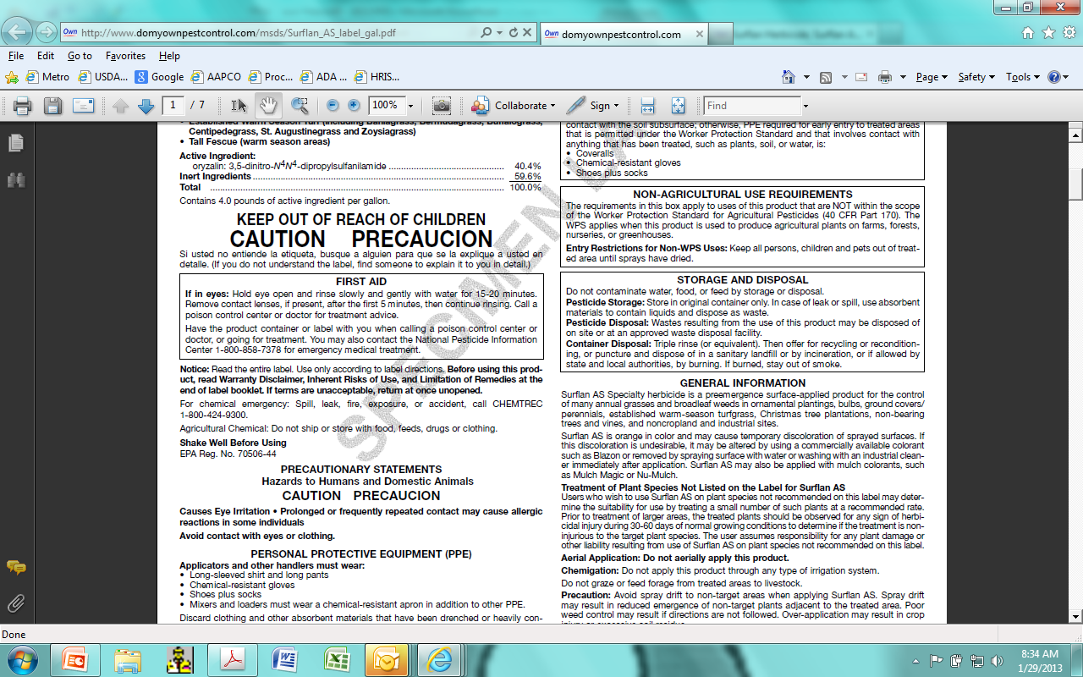

Slide 19
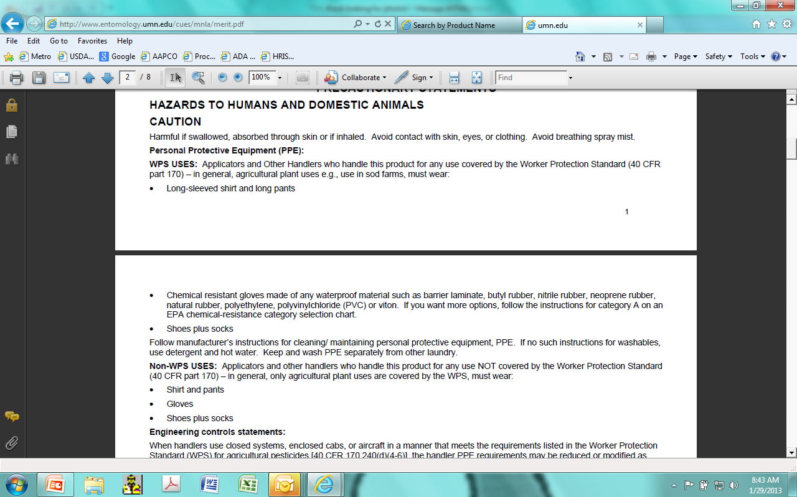

Slide 20
Spinosad
Personal Protective Equipment (PPE)
Applicators and other handlers must wear:
  • Long-sleeved shirt and long pants
  • Shoes plus socks
Mixers/loaders must wear:
  • An approved dust/mist filtering respirator (NSHAINIOSH approval number prefix TC-21 C), or NIOSH approved respirator with any N, R, P or HE filter.
  Follow manufacturer's instructions for cleaning/maintaining PPE. If no such instructions for washables, use detergent and hot water. Keep and wash PPE separately from other laundry.
PPE required for early entry to treated areas that is permitted under the Worker Protection Standard and that involves contact with anything that has been treated, such as plants, soil, or water, is:
  • Coveralls
  • Waterproof gloves
  • Shoes plus socks

Slide 21
Worker Protection Standard
(iii) When “chemical-resistant” personal protective equipment is specified by the product labeling, it shall be made of material that allows no measurable movement of the pesticide being used through the material during use.
(iv) When “waterproof” personal protective equipment is specified by the product labeling, it shall be made of material that allows no measurable movement of water or aqueous solutions through the material during use.

Slide 22
Glyphosate
PERSONAL PROTECTIVE EQUIPMENT(PPE):
Some of the materials that are chemical-resistant to this product are listed below. If you want more options, follow the instructions for category A on an EPA chemical-resistance category selection chart.
Applicators and other handlers must wear: Long-sleeved shirt, long pants, shoes plus socks, and chemical-resistant gloves made of any waterproof material such as natural rubber.
Do not enter or allow worker entry into treated areas during the restricted-entry interval (REI) of 12 hours.
PPE required for early entry to treated areas that is permitted under the Worker Protection Standard and that involves contact with anything that has been treated, such as plants, soil, or water, is:
coveralls, chemical-resistant gloves made of any waterproof material and shoes plus socks.
WHAT?

Slide 23
Lannate
PERSONAL PROTECTIVE EQUIPMENT
Applicators and others exposed to the diluted spray solution must wear:
Long-sleeved shirt and long pants.
Chemical resistant gloves such as barrier laminate or butyl rubber.
Shoes plus socks.
Protective eyewear.
Mixers, loaders, cleaners, repairers of application equipment, and others exposed to the concentrate must wear:
Long sleeve shirt and long pants.
Chemical-resistant gloves, such as barrier laminate or butylrubber.
Socks and chemical resistant footwear.
Protective eyewear.
Respirator as outlined below.
Chemical resistant apron.
PPE required for early entry to treated areas that is permitted under the Worker Protection Standard and that involves contact with anything that has been treated, such as plants, soil, or water, is:
Coveralls.
Chemical Resistant Gloves Category A (such as butyl rubber, natural rubber, neoprene rubber or nitrile rubber), all ~14 mils.
Shoes plus socks.
Protective eyewear.

Slide 24
Pronamide
Personal Protective Equipment (PPE):
Applicators and other handlers must wear:
• Coveralls over short-sleeved shirt and short pants
• Waterproof gloves
• Chemical-resistant footwear plus socks
• Chemical-resistant headgear for overhead exposure
• Chemical-resistant apron when cleaning equipment, mixing or loading
PPE required for early entry to treated areas that is permitted under the Worker Protection Standard and that involves contact with anything that has been treated, such as plants, soil or water, is:
• Coveralls over short-sleeved shirt and short pants
• Waterproof gloves
• Chemical-resistant footwear plus socks
• Chemical-resistant headgear for overhead exposure

Slide 25
Maneb
Applicators and other handlers (other than mixers or loaders) must wear:
- Coveralls over long-sleeved shirt and long pants·
- Chemical resistant gloves made of any waterproof material, such as nitrile, latex, or barrier laminate
- Shoes plus socks
Mixers and Loaders must wear:
- Coveralls over long-sleeved shirt and long pants
- Chemical resistant gloves made of any waterproof material, such as nitrile, latex, or barrier laminate
- Shoes plus socks
- Protective eyewear
- Chemical-resistant apron when mixing and loading
Do not enter or allow worker entry into treated areas during the restricted entry interval (REI) of 24 hours.
PPE required for early entry to treated areas that is permitted under the Worker Protection Standard and that involves contact with anything that has been
treated, such as plants, soil, or water, is:
- Coveralls over long-sleeved shirt and long pants
- Chemical resistant gloves made of any waterproof material, such as nitrile, latex, or barrier laminate
- Shoes plus socks

Slide 26
chlorpyrifos
Personal Protective Equipment (PPE)
Materials that are chemical-resistant to this product are barrier laminate and viton.
Loaders, applicators and all other handlers must wear:
• Coveralls over long-sleeved shirt and long pants
• Chemical-resistant gloves
• Chemical-resistant footwear plus socks
• A NIOSH-approved dust mist filtering respirator with…
Some materials resistant to this product are barrier laminate or viton. For more information, follow instructions in Supplement Three of PR Notice 93-7. If you want more options, follow the instructions for Category H on an EPA…

Slide 27
Paraquat
Applicators and other handlers (other than mixers and loaders) must wear:
• Long-sleeved shirt and long pants
• Chemical Resistant Gloves - Category A (e.g., barrier laminate, butyl rubber, nitrile rubber, neoprene rubber, natural rubber, polyethylene, polyvinyl chloride (PVC) or viton)
• Shoes plus socks
• Protective eyewear
• A dust mist NIOSH-approved respirator with any N, R, P, or HE filter
Mixers and loaders must wear:
• Long-sleeved shirt and long pants
• Chemical Resistant Gloves - Category A (e.g., barrier laminate, butyl rubber, nitrile rubber, neoprene rubber, natural rubber, polyethylene, polyvinyl chloride (PVC) or viton)
• Shoes plus socks
• Dust mist NIOSH-approved respirator with ANY N, R, P, or HE filter.
• Chemical resistant apron
• Face Shield

Slide 28
PPE Conclusion Thoughts
Need to be required
Need to be self explanatory
  Categorizing
Need to be consistent within the appropriate toxicity
  Label consistency
Need to ensure protection against AI
= enforceable

Slide 29

Enforcement Issues with Glove and Garment Statements
/Comments
Jack Peterson
Arizona Department of Agriculture
jpeterson@azda.gov
602-542-3575

